Slide 1
Laser Particle Image Velocimetry (PIV)
By: Michael Norville

Slide 2
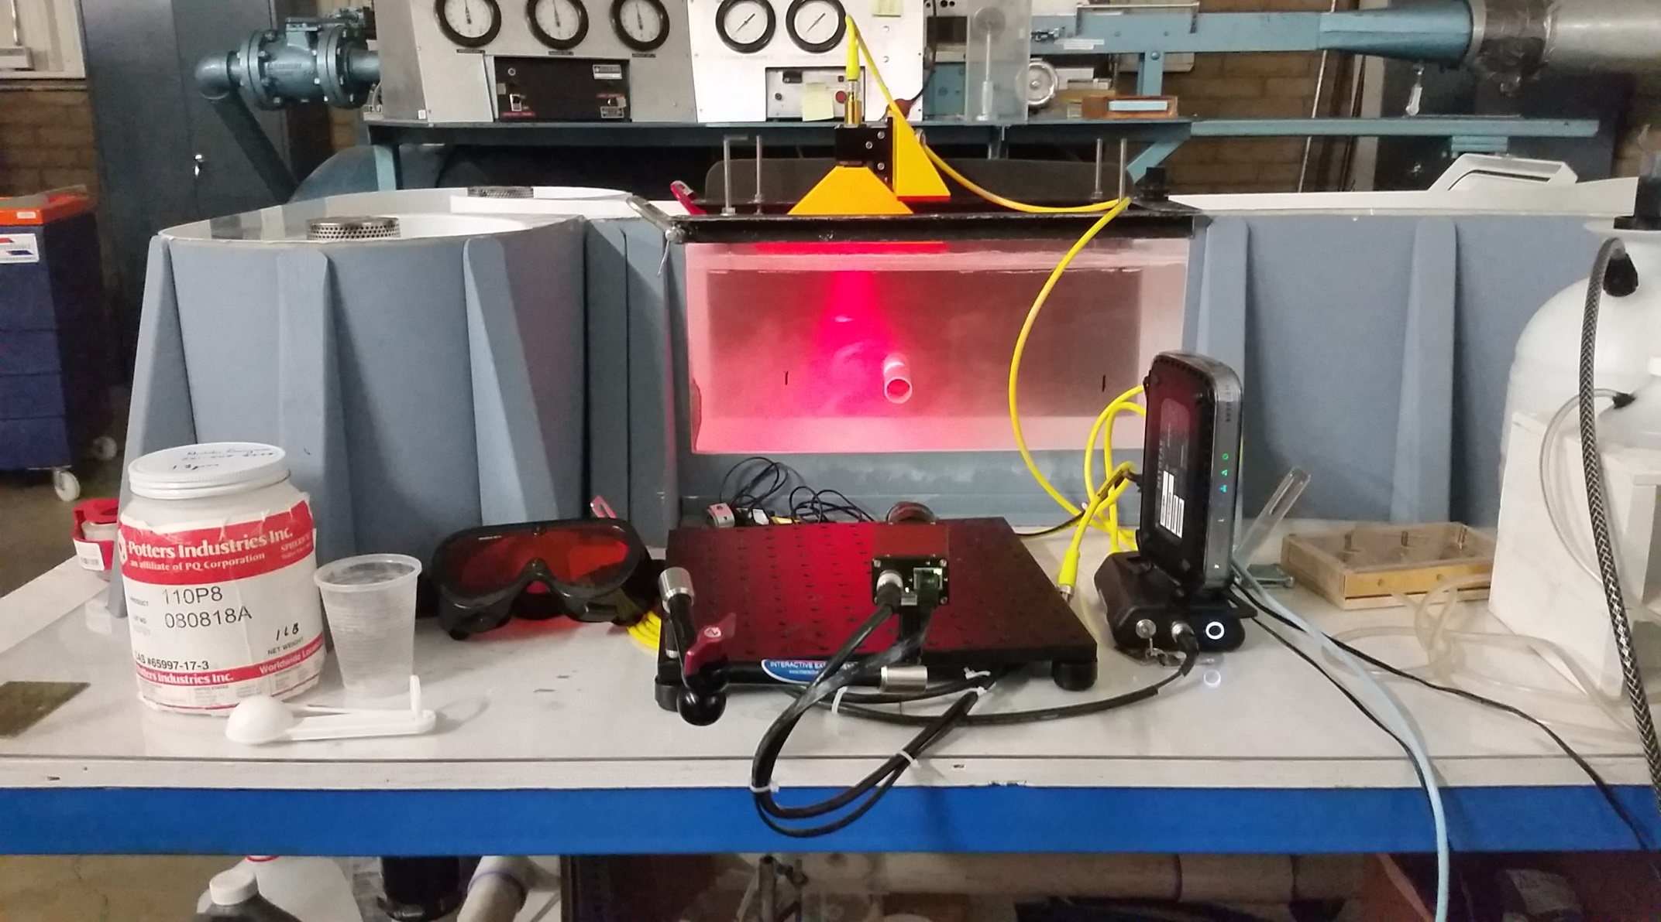
Laser PIV System
Laser
Particles
Test Specimen
Googles
Router
Synchronizer
Camera

Slide 3
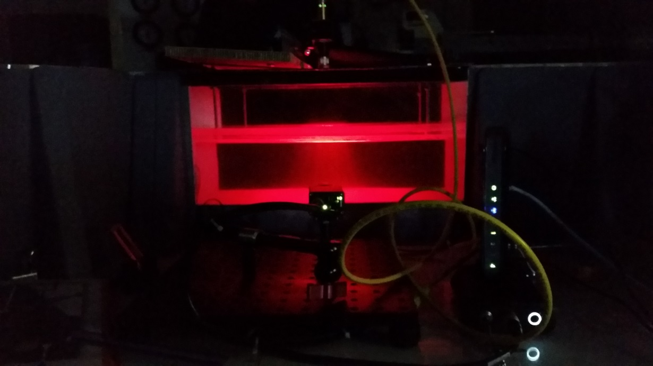
Procedure
Research on past PIV
Types of systems
Particles
Freestream Flow
Cylindrical Flow

Slide 4
Particles
Particle Type | Size(μm) | Density (g/cm³) | Reflectivity | Company
Hollow Glass Spheres (HGS) | 18 - 81 | 0.23-1.15 | 1.52 | Potter LLC
Polyamide Seeding Particles (PSP) | 1 - 70 | 1.03 | 1.5 | Dantec
Fluoresecent Polymer Particles (FPP) | 1 - 100 | 1.5 | 1.68 | Dantec
Polysyrene Latex (PSL) | 0.4 - 0.6 | 1.05 | 1.55 | TSI
Metallic Coated HGS | 2 - 20 | 1.65 | 2.62 | TSI
Silicon Carbide | 1.1-1.9 | 3.2 | 2.65 | TSI
Titanium Dioxide | 3 - 5 | 4.2 | 2.6 | TSI

Slide 5
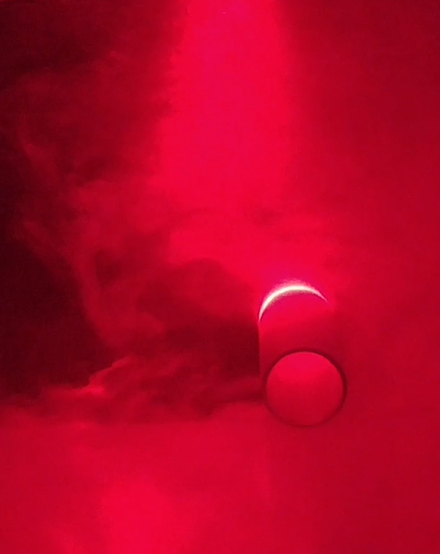
Improving Lighting
Vary particle size
Vary particle reflectivity
Vary laser power
Adjust camera aperture
Adjust background light
Adjust time-step

Slide 6
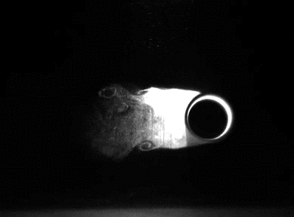
Improving Video Quality
Adjust time-step
Adjust water velocity
Adjust camera focus
Adjust camera distance from laser sheet
Adjust the distance from laser to the test object

Slide 7
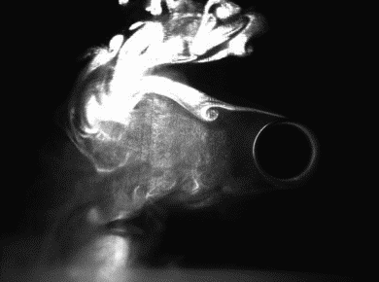


Slide 8
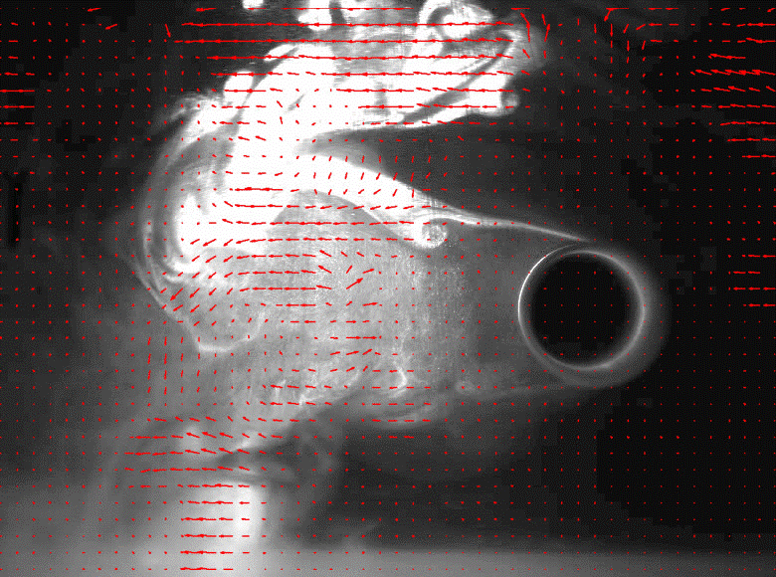
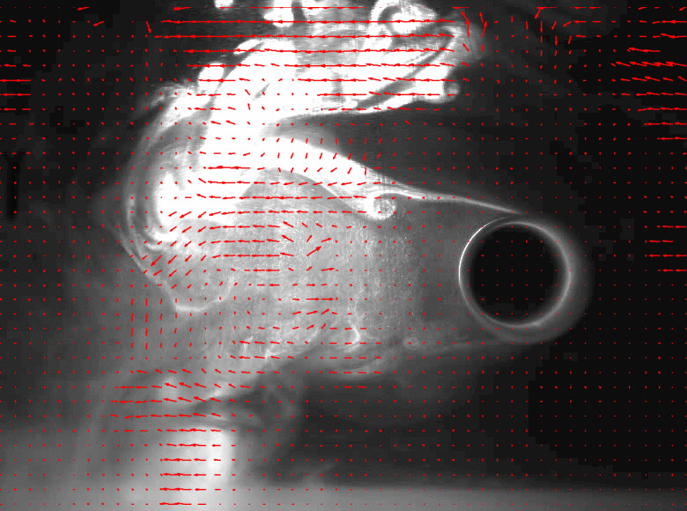
Cylinder Research

Slide 9
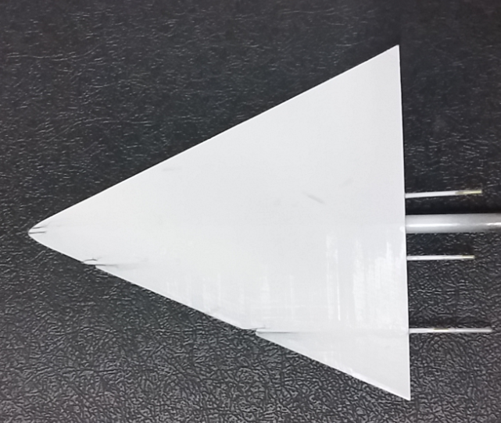
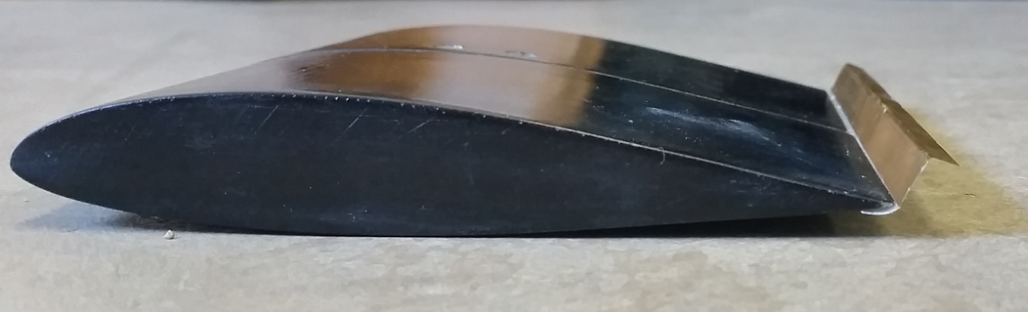
Future Uses
Analyze various wing configurations
Delta Wing
Gurney Flaps
ERAU’s Experimental Aerodynamics class

Slide 10
Special Thanks
Nick Valois
Dr. Lance Traub
Dr. Gary Yale

Slide 11
References
"Tracer Particles and Seeding for PIV." University at Buffalo School of Engineering and Applied Sciences, n.d. Web. <http://www.eng.buffalo.edu/Courses/mae513/Lecture__Seeding_Particle_for_PIV.ppt>.
Melling, A. "Tracer Particles and Seeding for Particle Image Velocimetry." Measure. Science. Technology., n.d. Web. <http://iopscience.iop.org/article/10.1088/0957-0233/8/12/005/meta>.

Slide 12
Questions?

Slide 13
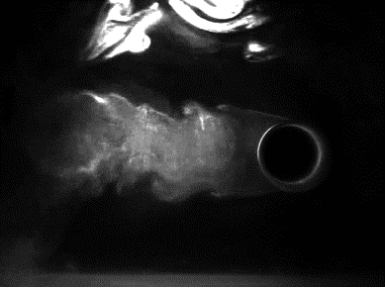
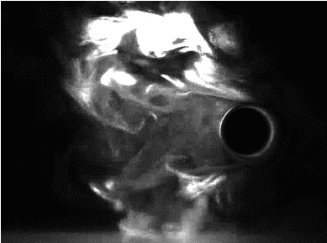
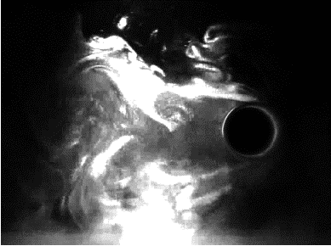
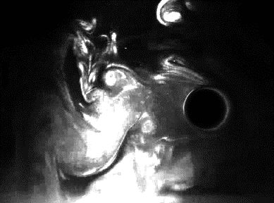

Slide 14
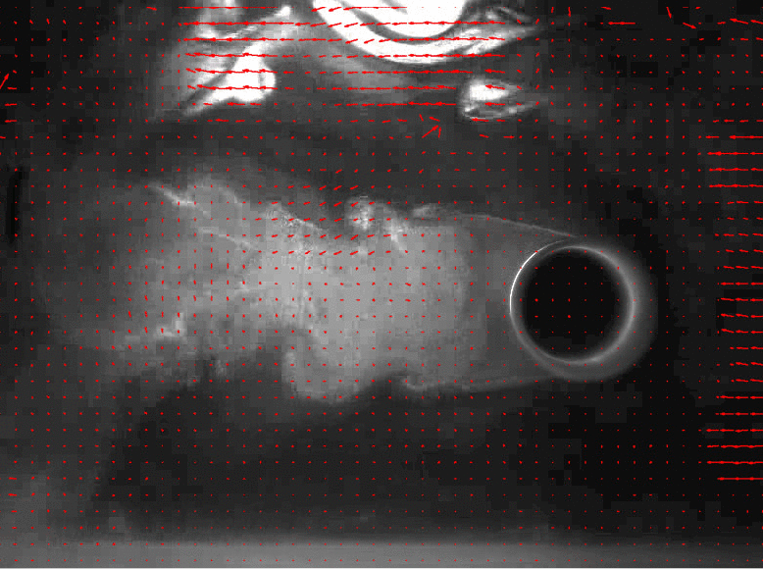
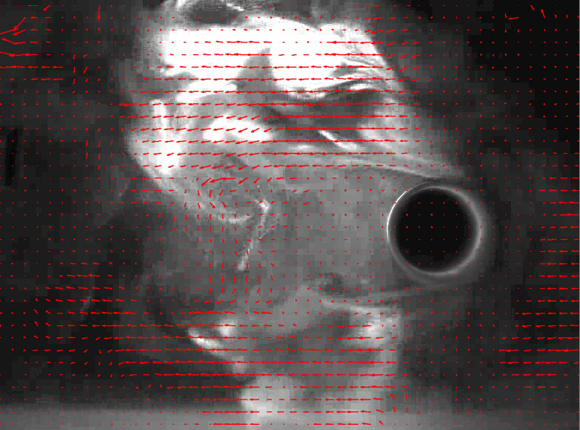
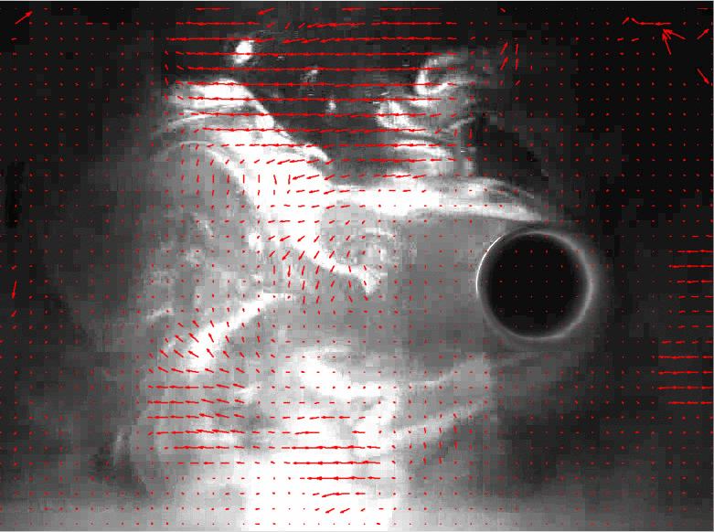
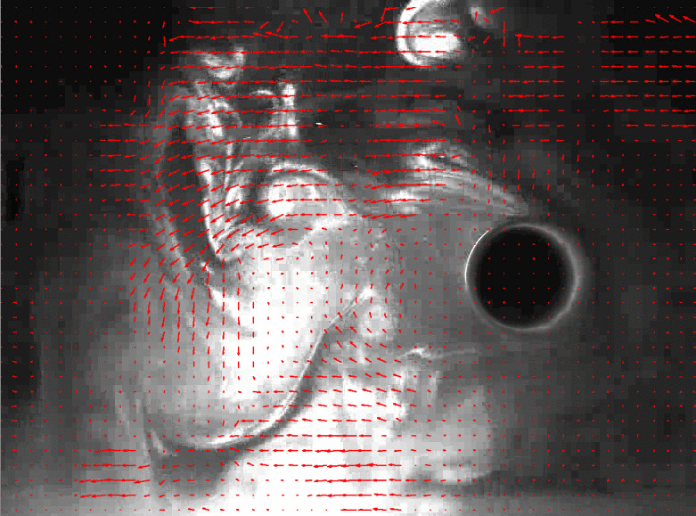

Slide 15
Equipment
200 mW red Laser (400-700 nm Class 3B)
Googles (certified to laser wavelength range)
Camera that provides 67 FPS at 780X580 pixels
Synchronizer
Particles (Hollow Glass Spheres: 18um-81um)
Water Tunnel (25Hz equivalent to 15 cm/s)
Computer
FlowEx Software
Gigabit Router

Slide 16
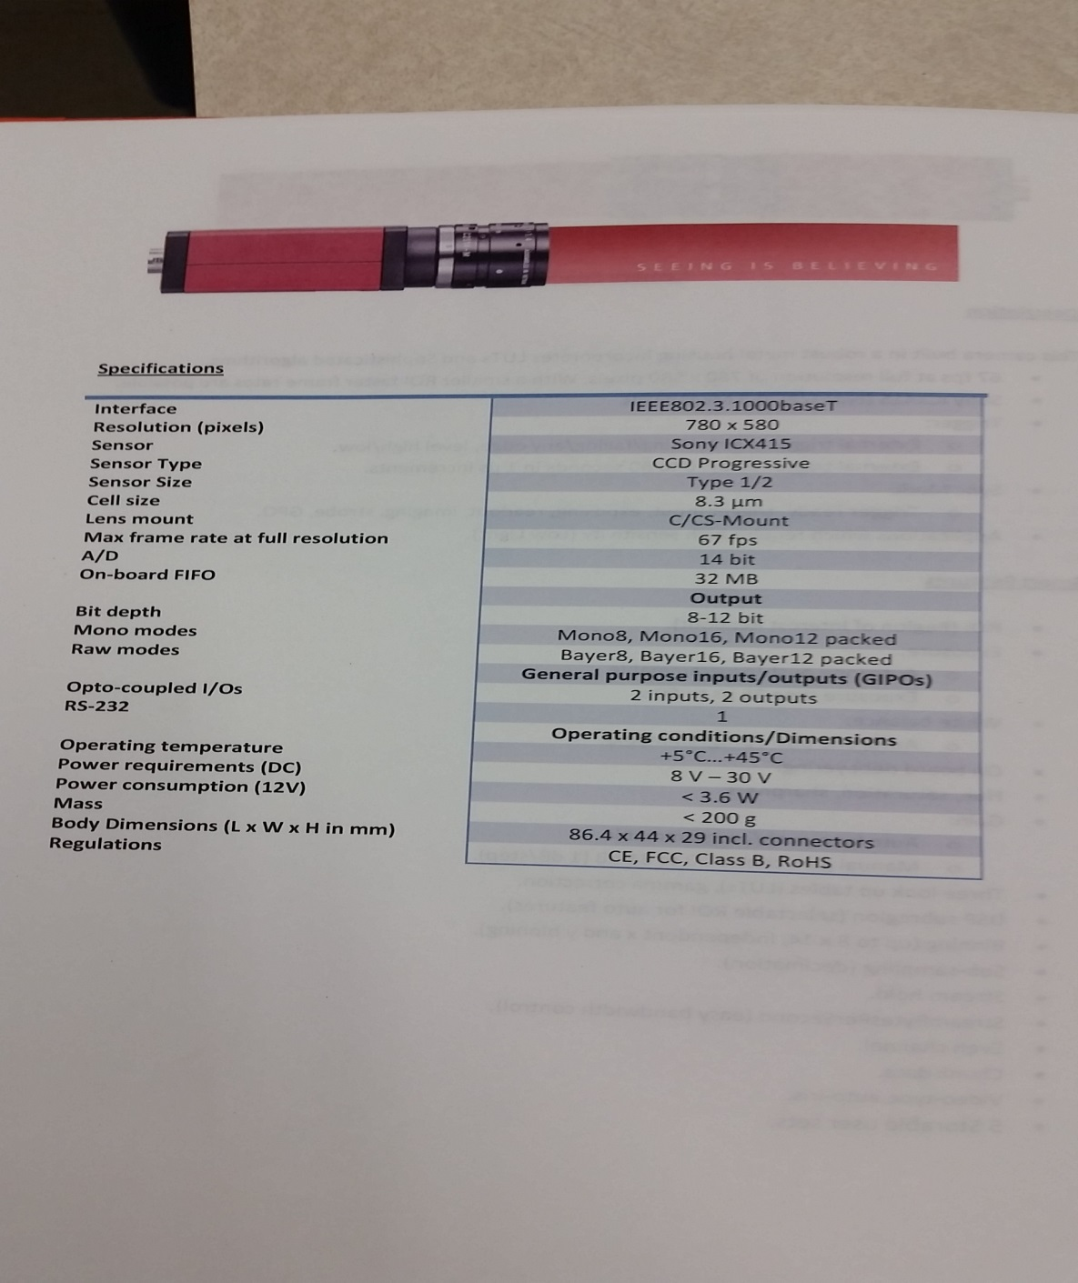
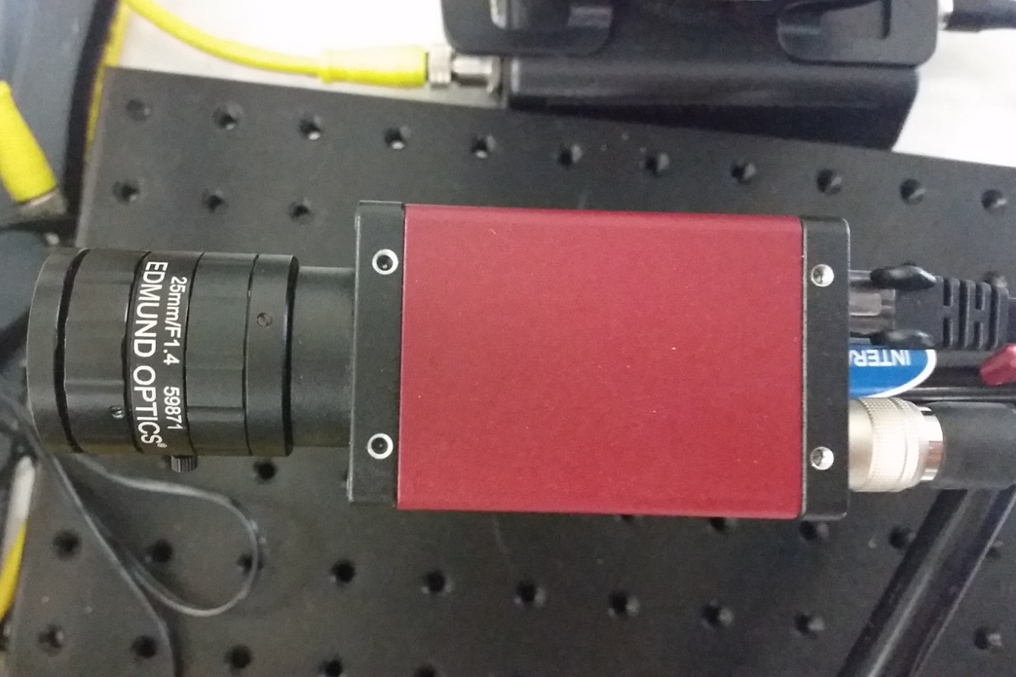
Camera

Slide 17
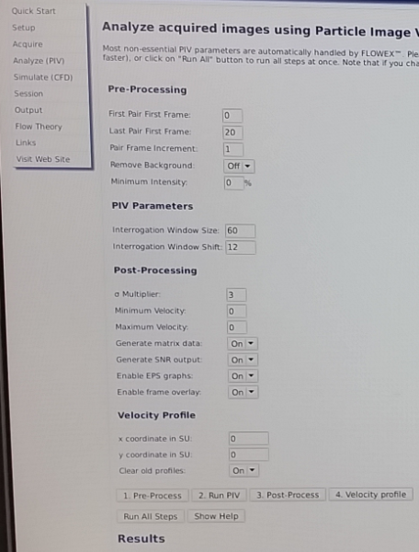
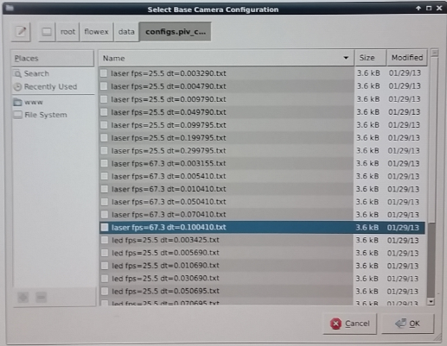
Software

